Slide 1
Unit 5 (Contd ….)
Bayes Network

Slide 2
Why Bayes Network
To represent the probabilistic relationship between two different classes
To avoid dependences between value of attributes by joint conditional probability distribution
In Naïve Bayes Classifier, attributes are conditionally independent

Slide 3
Bayesian Belief Network
BN are also known as Bayesian Network, Belief Networks and Probabilistic Networks
A BN is defined by two parts, Directed Acyclic Graph (DAG) and Conditional Probability Tables (CPT)
Nodes → Random Variables
Arcs→ Indicates Probabilistic dependencies between nodes

Slide 4
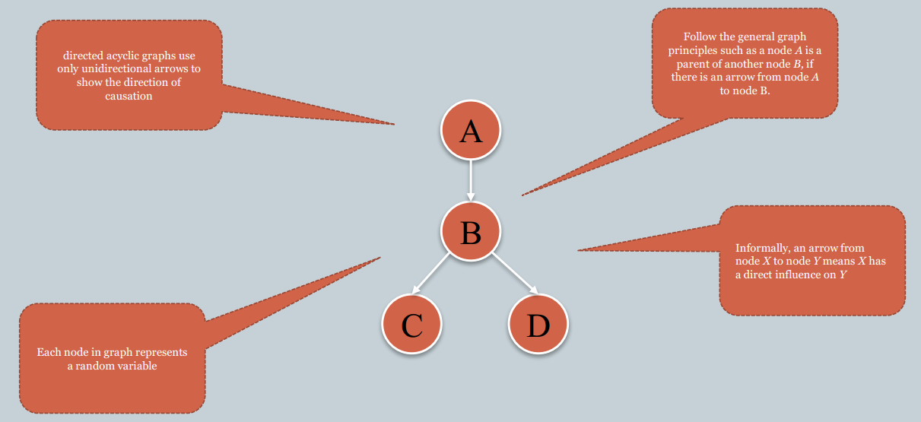
Bayesian Belief Network (DAG)

Slide 5
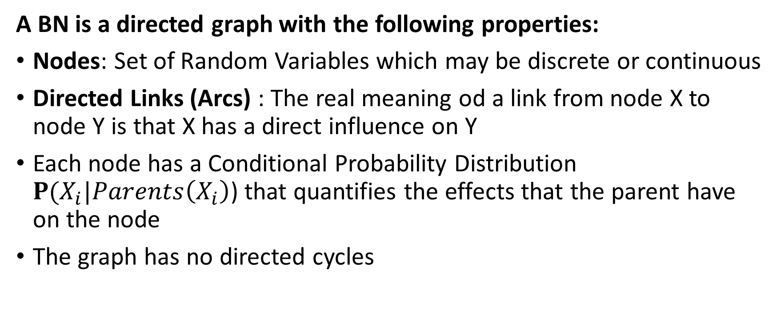
Bayesian Belief Network
A BN is a directed graph with the following properties:
Nodes: Set of Random Variables which may be discrete or continuous
Directed Links (Arcs) : The real meaning od a link from node X to node Y is that X has a direct influence on Y
Each node has a Conditional Probability Distribution $P(X_{i}|Parents\left(X_{i}\right)$) that quantifies the effects that the parent have on the node
The graph has no directed cycles

Slide 6
Bayesian Belief Network
A BN is a directed graph with the following properties (contd…)
If an arc is drawn from Y to Z, then Y is a parent or immediate predecessor of Z, and Z is a descendant of Y
Each variable is conditionally independent of its non-descendants in the graph, given its parents
Y
Z

Slide 7
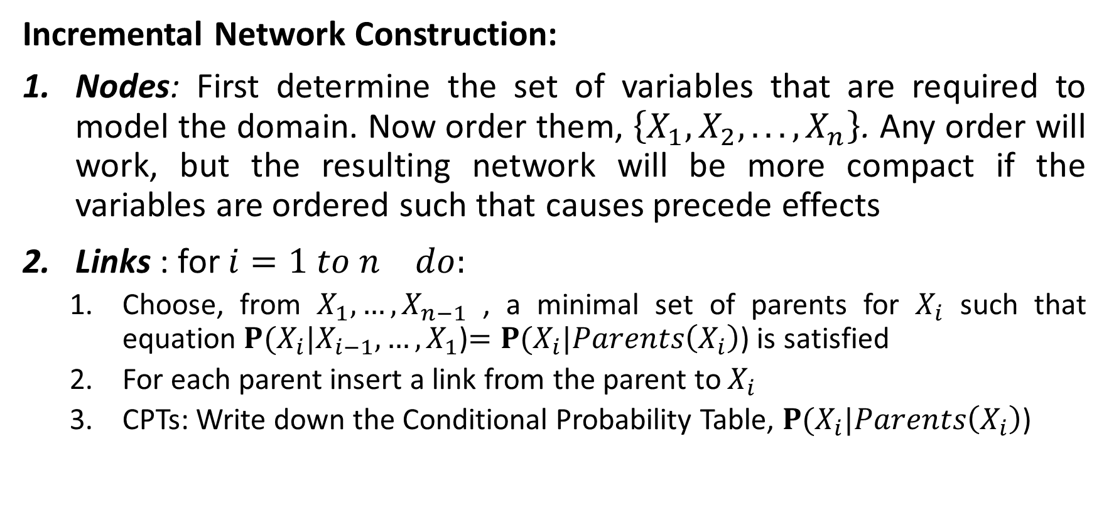
Bayes Belief Network
Incremental Network Construction:
Nodes: First determine the set of variables that are required to model the domain. Now order them, $\left\{X_{1},X_{2}, . . . ,X_{n}\right\}$. Any order will work, but the resulting network will be more compact if the variables are ordered such that causes precede effects
Links : for ${i=1 to n}^{} do:$
Choose, from $X_{1},…,X_{n−1}$ , a minimal set of parents for $X_{i}$ such that equation $P(X_{i}|X_{i−1}, …,X_{1}$)$=P(X_{i}|Parents\left(X_{i}\right)$) is satisfied
For each parent insert a link from the parent to $X_{i}$
CPTs: Write down the Conditional Probability Table, $P(X_{i}|Parents\left(X_{i}\right)$)

Slide 8
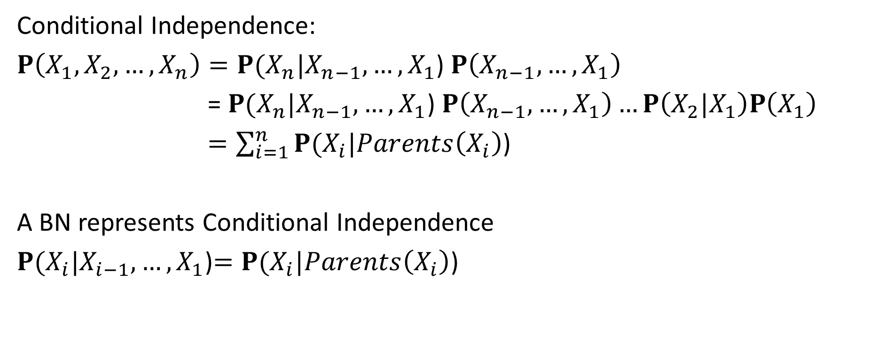
Bayes Belief Network
Conditional Independence:
$P\left(X_{1},X_{2},…,X_{n}\right)=P(X_{n}|X_{n−1}, …,X_{1}$) $P\left(X_{n−1}, …,X_{1}\right)$
= $P(X_{n}|X_{n−1}, …,X_{1}$) $P\left(X_{n−1}, …,X_{1}\right)…P\left(X_{2}|X_{1}\right)P\left(X_{1}\right)$
$=\sum_{i=1}^{n}{P(X_{i}|Parents\left(X_{i}\right)\text{)}}$
A BN represents Conditional Independence
$P(X_{i}|X_{i−1}, …,X_{1}$)$=P(X_{i}|Parents\left(X_{i}\right)$)

Slide 9
Bayes Belief Network
Example
Burglar Alarm at Home
Fairly reliable at detecting a Burglary
Also Respond at times of Earthquake
Two neighbours (John and Mary) on hearing Alarm calls you
John always calls when he hears the alarm, but sometimes confuses the telephone ringing with the alarm and calls then too
Mary likes aloud music and sometimes misses the alarm altogether

Slide 10
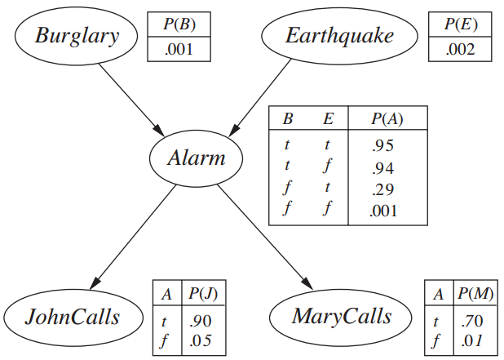
Bayes Belief Network

Slide 11
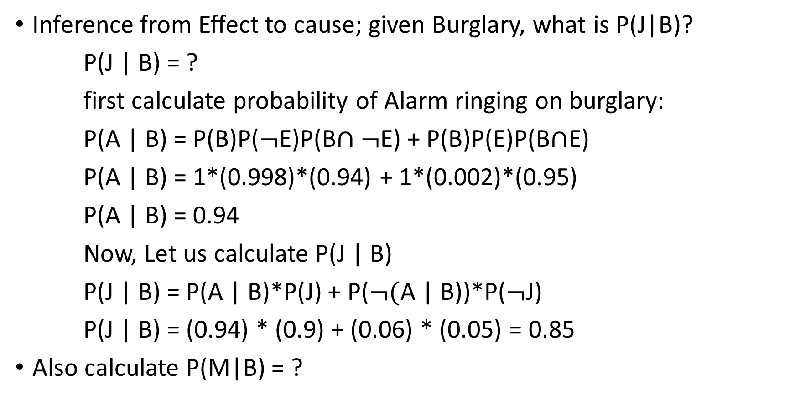
Bayes Belief Network
Inference from Effect to cause; given Burglary, what is P(J|B)?
P(J | B) = ?
first calculate probability of Alarm ringing on burglary:
P(A | B) = P(B)P($¬$E)P(B$∩¬$E) + P(B)P(E)P(B$∩$E)
P(A | B) = 1*(0.998)*(0.94) + 1*(0.002)*(0.95)
P(A | B) = 0.94
Now, Let us calculate P(J | B)
P(J | B) = P(A | B)*P(J) + P($¬($A | B))*P($¬$J)
P(J | B) = (0.94) * (0.9) + (0.06) * (0.05) = 0.85
Also calculate P(M|B) = ?

Slide 12
Bayes Belief Network
It can readily handle incomplete data sets
It allows one to learn about causal relationships
It readily facilitate use of prior knowledge
It Provide a natural representation for conditional independence
It is more complex to construct the graph

Slide 14
Markov Network
The canonical probabilistic model of temporal or sequential data is called Markov Model or Markov Network
“Future is independent of the past given the present”
They model a process that proceeds in steps (time, sequence, trials, etc.); like a series of probability trees

Slide 15
Markov Model
Examples:
What is the World at the end of this …………….. ?
Notes:
Let Data be :
$$D=\left(x_{1},x_{2}, …,x_{n}\right) which is sequential data$$
Let us model this data to Probabilistic Random data: $X_{1},…,X_{n}$
Here $X_{t} depends onX_{t−1},X_{t−2},{…,X}_{t−m}$ where m is fixed value

Slide 16
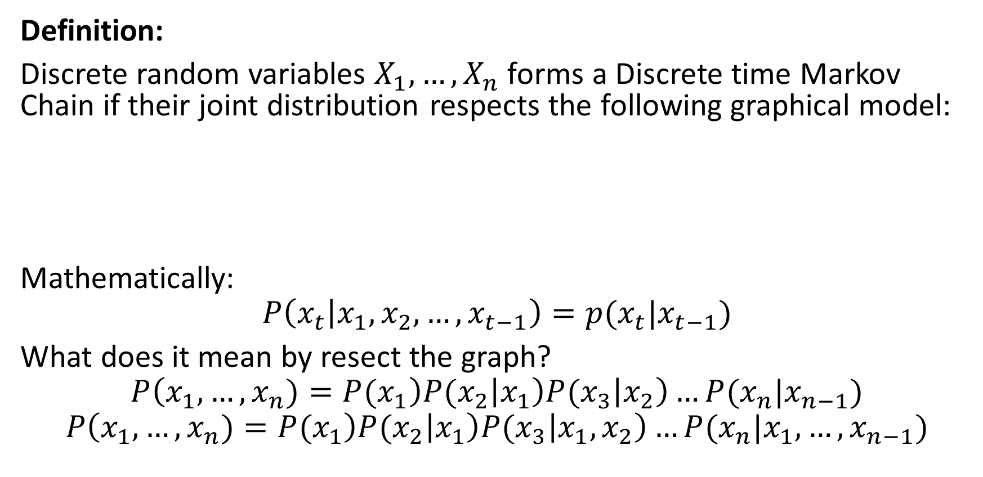




Markov Model
Definition:
Discrete random variables $X_{1},…,X_{n}$ forms a Discrete time Markov Chain if their joint distribution respects the following graphical model:
Mathematically:
$$P\left(x_{t} | x_{1},x_{2},…,x_{t−1}\right)=p(x_{t}|x_{t−1})$$
What does it mean by resect the graph?
$$P\left(x_{1}, …,x_{n})={P(x}_{1}\right){P(x}_{2}\left|x_{1}\right){P(x}_{3}\left|x_{2}\right)…{P(x}_{n}|x_{n−1})$$
$$P\left(x_{1}, …,x_{n})={P(x}_{1}\right){P(x}_{2}\left|x_{1}\right){P(x}_{3}\left|{x_{1},x}_{2}\right)…{P(x}_{n}|x_{1},…,x_{n−1})$$
…
$$X_{1}$$
$$X_{2}$$
$$X_{3}$$
$$X_{n}$$

Slide 17
Markov Model
Applications:
Weather forecast
Financial Analysis
Language processing like Speech to Text Conversion or speech recognition
Image tracking : Robot takes input as image and tries to find your next position by reading your coordinate
Diagnosis : To self amend the internal state of machine. Ex. Mars Rovers use this to diagnosis if its wheels are broken and fix itself
Bioinformatics : to determine how the patients are reacting toward the medication

Slide 18
Markov Model
Summary:
They are combination of probabilities and matrix operations
They model a process that proceeds in steps(time, sequence, trials, etc.); like series of probability trees
The model can be in one “state” at each step
When the next step occurs, the process can be in the same state or move to another state
Movements between states are defined by probabilities
We can then find the probability of being in any given state many steps into the process

Slide 20
Dynamic Bayes network
A Dynamic Bayesian Network (DBN) is a Bayesian Network which relates variables to each other over adjacent time steps.
This is often called a Two-Timeslice BN because it says that at any point in time T, the value of a variable can be calculated from the internal regressors and the immediate prior value (time T-1).
DBNs are common in robotics, and have shown potential for a wide range of data mining applications. For example, they have been used in speech recognition, digital forensics, protein sequencing, and bioinformatics.
DBN is a generalization of hidden Markov models and Kalman filters.

Slide 21











Hidden Markov Model(HMM)
An HMM is a stochastic finite automation, where each state generates(emits) an observation.
Let $X_{t}$ = hidden states / variables and $Y_{t}$ = observations and m = possible states then $X_{t}$ ε {1, 2, … , m} and $Y_{t}$ ε {1,2, … , m}
…
$$X_{1}$$
$$X_{2}$$
$$X_{m}$$
$$X_{1}$$
$$X_{2}$$
$$X_{m}$$
$$X_{1}$$
$$X_{2}$$
$$X_{m}$$
$$X_{1}$$
Hidden / latent variable
Trellis Diagram
$$Y_{1}$$
$$Y_{m}$$
$$Y_{1}$$
$$Y_{2}$$
$$Y_{m}$$
$$Y_{2}$$
observed

Slide 22

Hidden Markov Model
The Joint Distribution of Trellis Graph respects following:
$$p\left(X_{1}, …,X_{m},Y_{1}, …,Y_{m}\right)=p\left(X_{1}\right)p(Y_{1}|X_{1})\prod_{k=2}^{m}{p(X_{k}|X_{k−1})p(Y_{k}|X_{k})}$$

Slide 23

HMM
Instance
We can regard the weather as three states：
state1：Rain
state2：Cloudy
state3：Sun
 |  | Tomorrow
 |  | Rain | Cloudy | Sun
Today | Rain | 0.4 | 0.3 | 0.3
 | Cloudy | 0.2 | 0.6 | 0.2
 | Sun | 0.1 | 0.1 | 0.8
We can obtain the transition matrix with long term observation

Slide 24
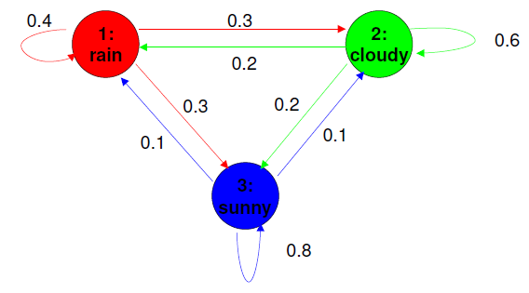
HMM
Fig: State Diagram

Slide 25
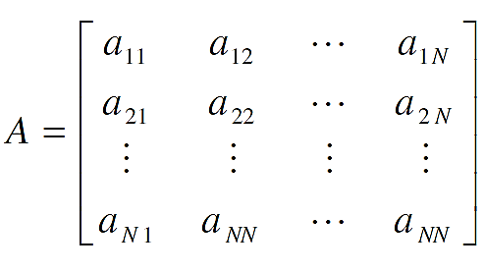
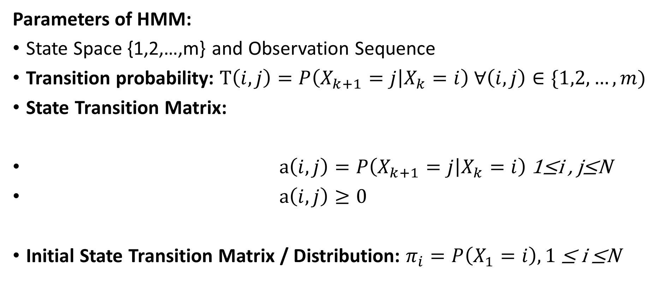
HMM
Parameters of HMM:
State Space {1,2,…,m} and Observation Sequence
Transition probability: $T\left(i,j\right)=P\left(X_{k+1}=j | X_{k}=i\right) ∀\left(i,j\right)∈\{1,2, …,m)$
State Transition Matrix:
$a\left(i,j\right)=P\left(X_{k+1}=j | X_{k}=i\right)$1≤i , j≤N
$a\left(i,j\right)≥0$
Initial State Transition Matrix / Distribution: $π_{i}=P\left(X_{1}=i\right), 1$ ≤ i ≤N

Slide 26
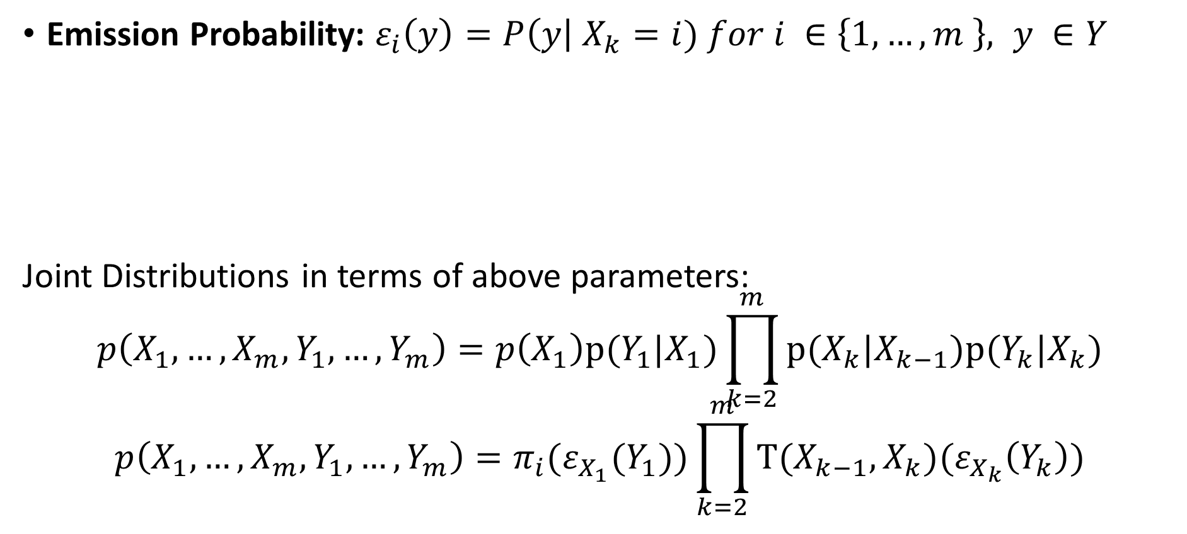
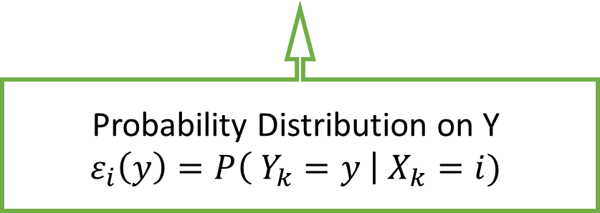
HMM
Emission Probability: $ε_{i}\left(y\right)=P\left(y\right| X_{k}=i) for i ∈\left\{1,…,m \right\}, y ∈Y$
Joint Distributions in terms of above parameters:
$$p\left(X_{1}, …,X_{m},Y_{1}, …,Y_{m}\right)=p\left(X_{1}\right)p(Y_{1}|X_{1})\prod_{k=2}^{m}{p(X_{k}|X_{k−1})p(Y_{k}|X_{k})}$$
$$p\left(X_{1}, …,X_{m},Y_{1}, …,Y_{m}\right)=π_{i}{(ε}_{X_{1}}(Y_{1}))\prod_{k=2}^{m}{T(X_{k−1},X_{k})(ε_{X_{k}}\left(Y_{k}\right))}$$
Probability Distribution on Y
$$ε_{i}\left(y\right)=P\left( Y_{k}=y \right| X_{k}=i)$$
Notes:
→ Emission Probability is arbitrary i.e. Discrete or Random or Real Values

Slide 27
HMM
What’s the probability of producing the sequence “aab” for this stochastic process?
a₁₁ 0.3
a₂₂ 0.4
a
b
0.80.2
a
b
0.30.7
S₁
S₂
S₃
a₂₃ 0.6
a₁₂ 0.5
a
b
a
b
0.50.5
1
0
a₁₃ 0.2
a
b
0
1

Slide 28
HMM
INSTANCE 1:
a₁₁ 0.3
a₂₂ 0.4
a
b
0.80.2
a
b
0.30.7
S₁
S₂
S₃
a₂₃ 0.6
a₁₂ 0.5
a
b
a
b
0.50.5
1
0
a₁₃ 0.2
a
b
0
1
S₁→S₁→S₂→S₃ 0.3*0.8*0.5*1.0*0.6*0.5=0.036

Slide 29
HMM
INSTANCE 2:
a₁₁ 0.3
a₂₂ 0.4
a
b
a
b
0.80.2
0.30.7
S₁
S₂
S₃
a₂₃ 0.6
a₁₂ 0.5
a
b
a
b
0.50.5
1
0
a₁₃ 0.2
a
b
0
1
S₁→S₂→S₂→S₃ 0.5*1.0*0.4*0.3*0.6*0.5=0.018

Slide 30
HMM
INSTANCE 3
a₁₁ 0.3
a₂₂ 0.4
a
b
a
b
0.80.2
0.30.7
S₁
S₂
S₃
a₂₃ 0.6
a₁₂ 0.5
a
b
a
b
0.50.5
1
0
a₁₃ 0.2
a
b
0
1
S₁→S₁→S₁→S₃ 0.3*0.8*0.3*0.8*0.2*1.0=0.01152
Therefore, the total probability is:
0.036+0.018+0.01152=0.06552

Slide 31






HMM
Forward Backward Algorithm:
used for Inference in HMM i.e Dynamic Programming first used by Richard Bellman
It assumes that we know emission probability and initial distribution
Comprises of Two Parts : Forward Algorithm and Backward algorithm
…
$$X_{1}$$
$$X_{2}$$
$$X_{m}$$
$$Y_{1}$$
$$Y_{2}$$
$$Y_{m}$$

Slide 32
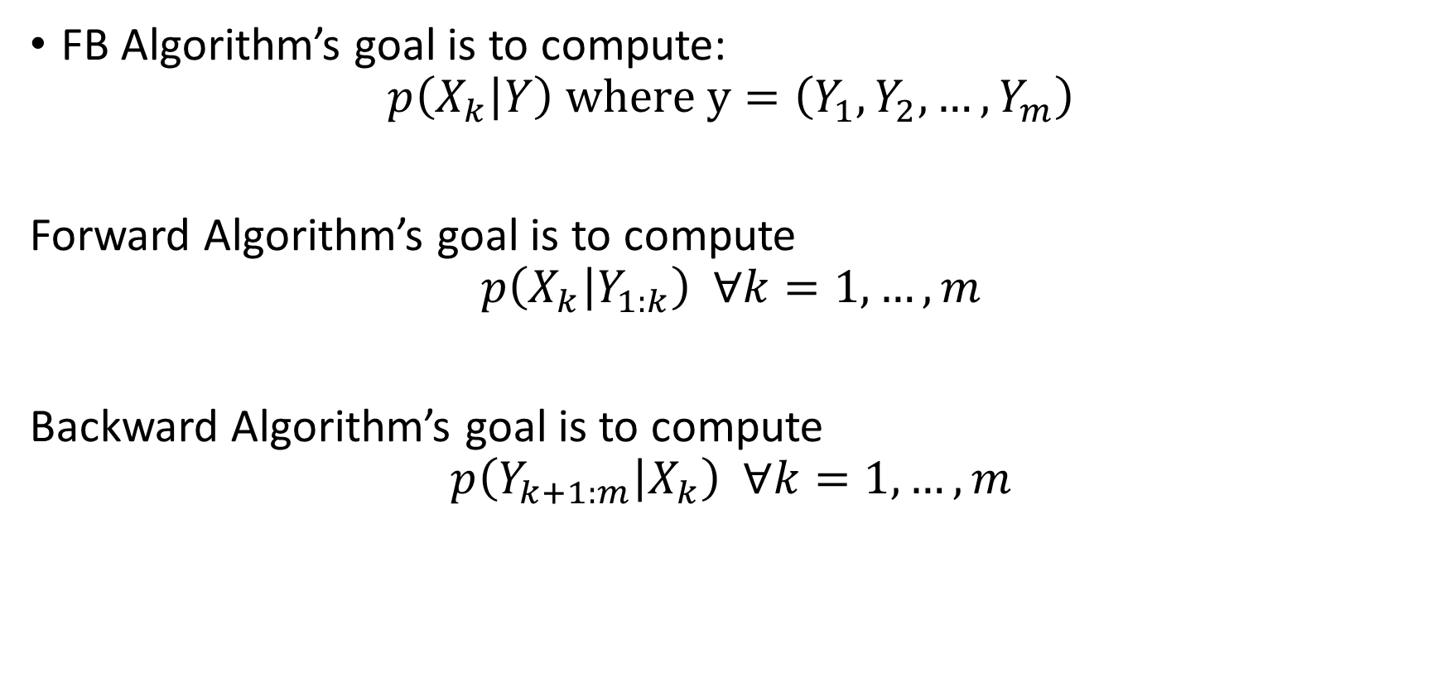
HMM
FB Algorithm’s goal is to compute:
$$p\left(X_{k} | Y\right) where y=\left(Y_{1},Y_{2}, …,Y_{m}\right)$$
Forward Algorithm’s goal is to compute
$$p\left(X_{k} | Y_{1:k}\right) ∀k=1, …, m$$
Backward Algorithm’s goal is to compute
$$p\left(Y_{k+1:m} | X_{k}\right) ∀k=1, …, m$$

